Slide 1
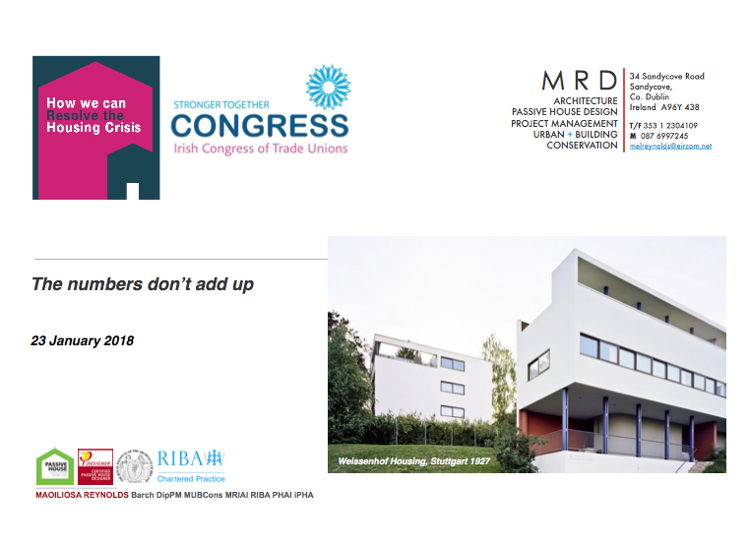

Slide 2
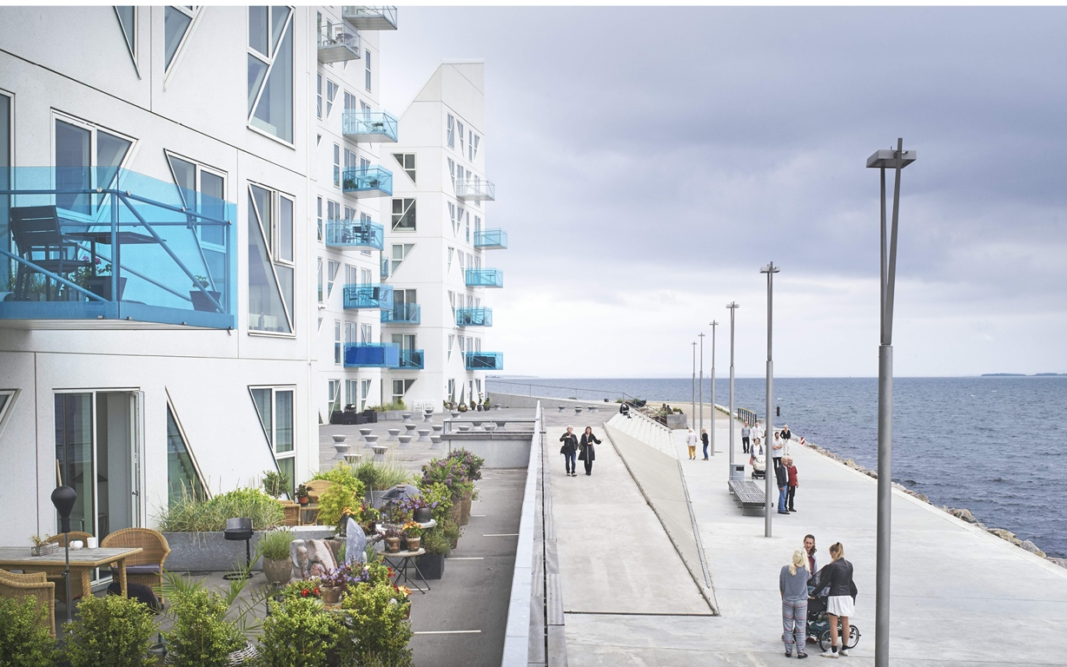
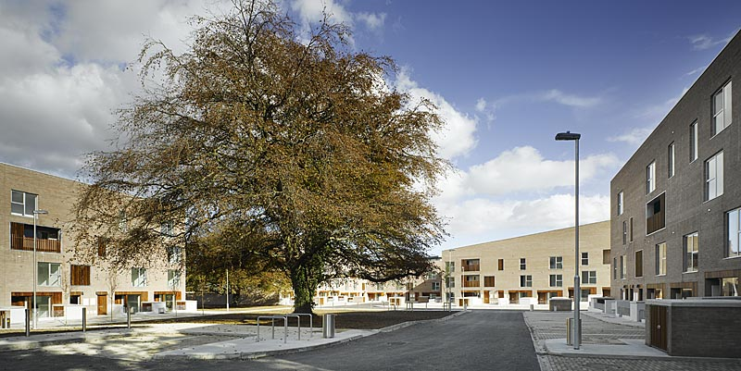
Introduction
Assumptions
Private Housing
Public Housing
Price, Affordability & solutions
Land
Conclusion
Iceberg Social Housing Denmark (CEBRA)
Affordable Housing Santry (DTA)

Slide 3
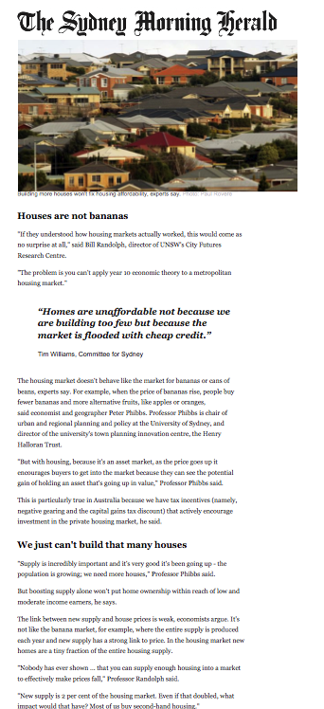
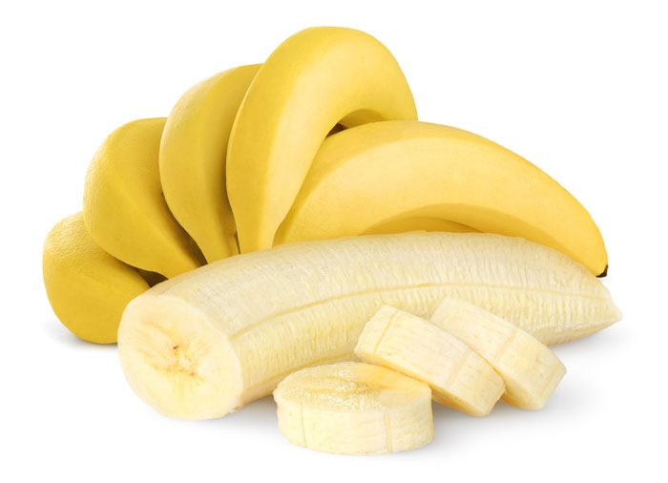
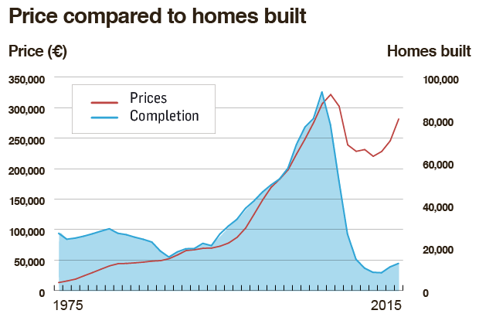
Assumption: Housing Supply & Price
Increasing supply hasn’t reduced price in 40 years

Slide 4
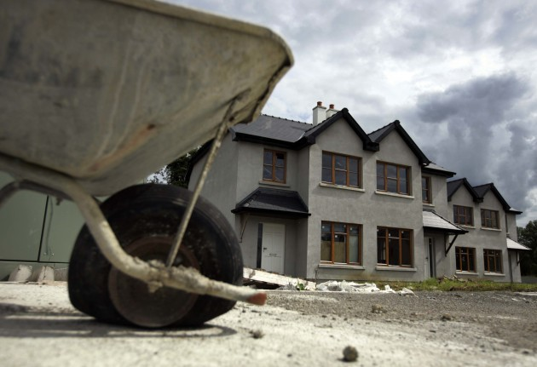
Private Housing Facts
7,600 new homes completed in 2017*
+2,500 net homes added to stock 2017 (+3,400 yoy)
183,000 existing vacant homes (x2 normal rate)
+10% price = + 30% land value
 | BER | Stamp Duty Transactions | New Build Total | BCMS Commencements | Planning Permissions | ESB Connections
12m | 6366 | 8656 | 7566 | 17572 | 18171 | 18883 (est)
index | 84 | 114 | 100 | 232 | 240 | 250
*Table: comparison of indicators vs Actual new homes output 2017. (Source: DHPCLG / CSO)

Slide 5
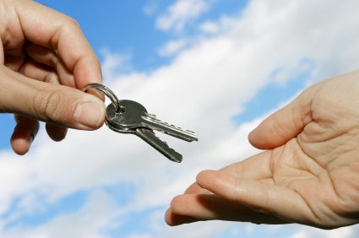
Public Housing Facts
1,053 pa Local Authority homes built 2017
Housing Assistance Payment (HAP) + 17,900 pa
Rent Assistance budget €730m pa (+€140m pa)
Dublin housing waiting lists: 40,200 (120,600 nationwide)
2-3 weeks of hap = output of local authority housing

Slide 6

Price & Affordability
30% of Households earn €35,000 - €73,000 pa
Maximum affordable price €240,000
Dublin existing home price €416,000
Av average new home €445,000
Affordability : Price = 3.5 x av. income limit
35% price= profit + land value

Slide 7
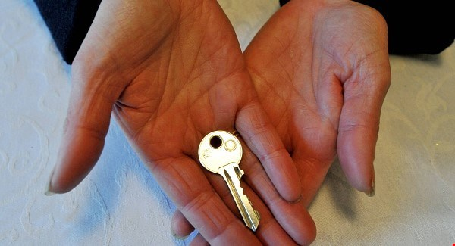
Housing Solutions: Private, State, ‘Other’
‘All In’ Private sector €330,000 (part V)
‘All In’ Local Authority Build €191,000
Other (coop) Build €200,000*
cheap land + lower profit= <€200k

Slide 8
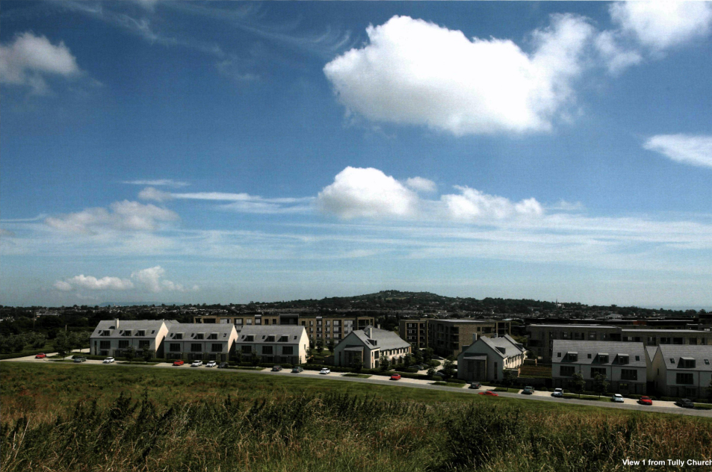
Local Authority Land
Rebuilding Ireland Land Survey
1,500 Ha Local Authority (LA) + 200 Housing Agency= 40,000 homes
305 Ha la Dublin zoned residential= 19,000 homes
State owns more land.
View of Proposed Development (source DLRCoCo)

Slide 9
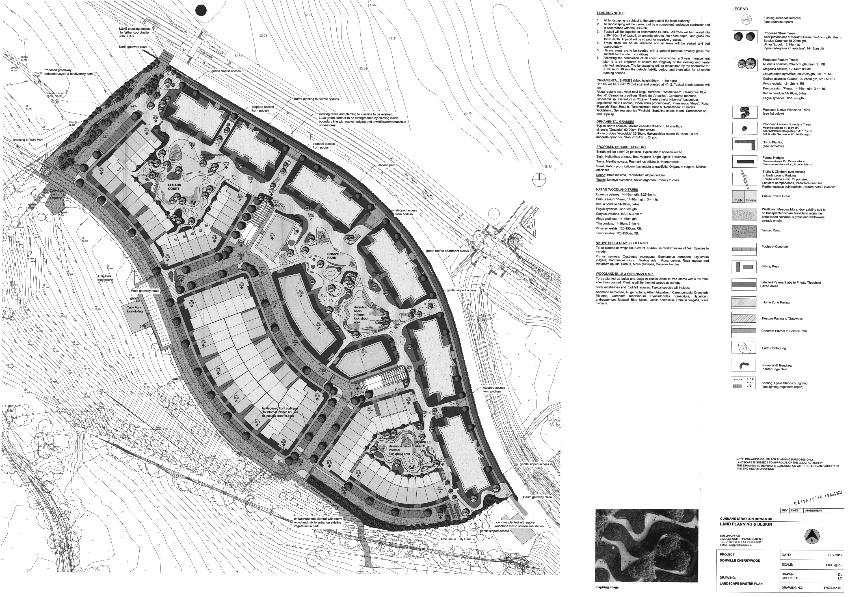




Conclusion
Spec. Build model can not deliver affordable housing
18,000 social + affordable homes require per year
7,000 private sector homes required pa
discounted land + lower profit = affordable
State must actively manage land
Landscaping Plan
Cherrywood Area 2
Cherrywood SDZ 820 Acres (331 Ha)
______________________
MAOILIOSA REYNOLDS Barch DipPM MUBCons MRIAI RIBA PHAI iPHA

