Slide 1
Working together in Europe – Eurofound data, analysis, and knowledge to support Congress Unions
ICTU
European Seminar ‘Congress Unions Working Together in Europe’
Barbara Gerstenberger, Eurofound
7 October 2024

Slide 2
Eurofound 2021-2024
Mission
Strategic objective
To provide knowledge to support the development of better informed social, employment and work-related policies
To provide scientifically sound, unbiased, timely and policy relevant knowledge that contributes to better informed polices to improve living and working conditions and strengthen cohesion in a changing Europe

Slide 3

The facts
100 staff members
EU agency
Budget of c. € 24 million
Established in 1975
Based in Dublin
Brussels Liaison Office

Slide 4

Eurofound – A tripartite agency
National
Governments
Employers
Trade Unions

Slide 5
Members on the Management Board from Ireland
 | Member | Alternate
Government | vacancy | Kieran Lea Department of Social Protection (Ireland)
Employers | Maeve McElwee Irish Business & Employers Confederation (IBEC) | Pauline O'Hare Irish Business & Employers Confederation (IBEC)
Unions | David Joyce Irish Congress of Trade Unions (ICTU) | Ger Gibbons Irish Congress of Trade Unions (ICTU)
Notes:
Information can be found at Management Board | European Foundation for the Improvement of Living and Working Conditions (europa.eu)

Slide 6
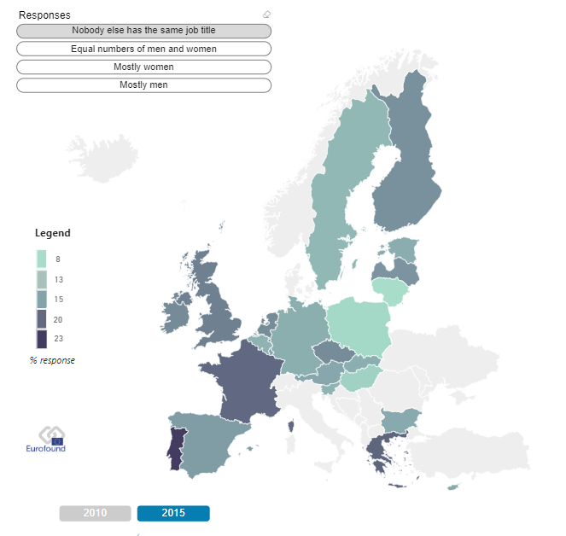
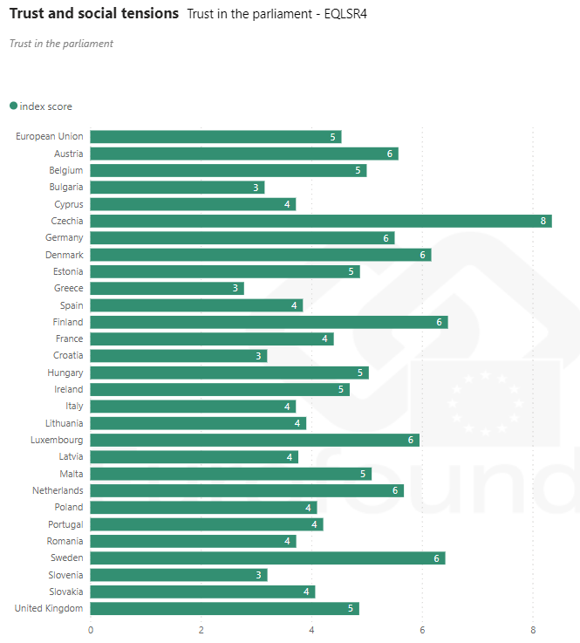
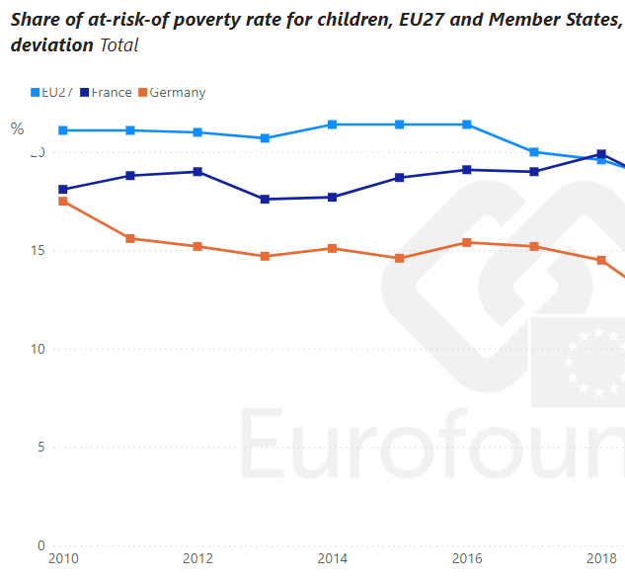
Comparative research

Slide 7

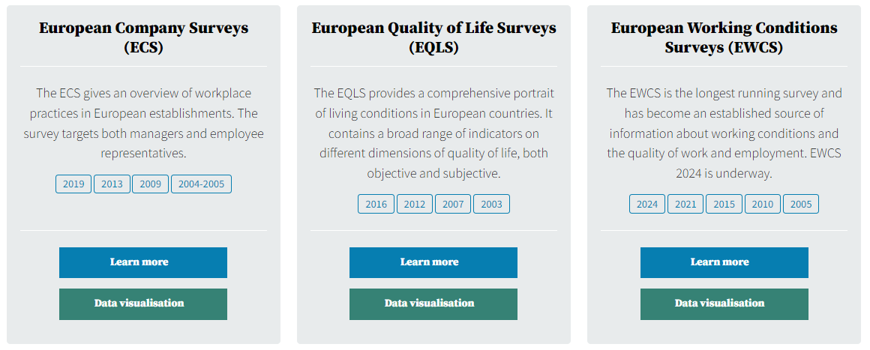

Europe-wide surveys

Slide 8
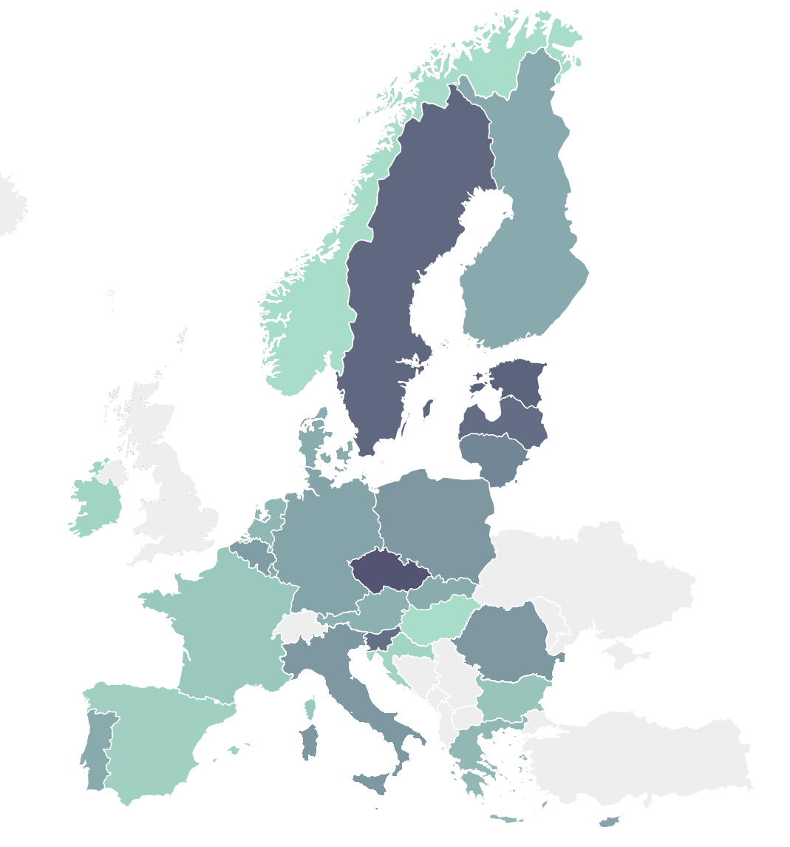
Network of Eurofound Correspondents
National Correspondent for Ireland | Consortium IRN Publishing Ltd & National University of Ireland, University College Dublin (NUID UCD) Correspondents: Rosanna Angel, Martin Macdonnell, Andy Prendergast, Brian Sheehan, Colman Higgins, Roisin Farrelly, David Murphy, Dr. Gerard McMahon, Herbert Mulligan, Prof. Tony Dobbins, Prof. John Geary
Correspondents report on the national level, from
All EU Member States
Norway
Notes:
Information is available at NEC 2022-26 - Contractors - list of names as per 1 March 2024.XLSX (sharepoint.com)

Slide 9
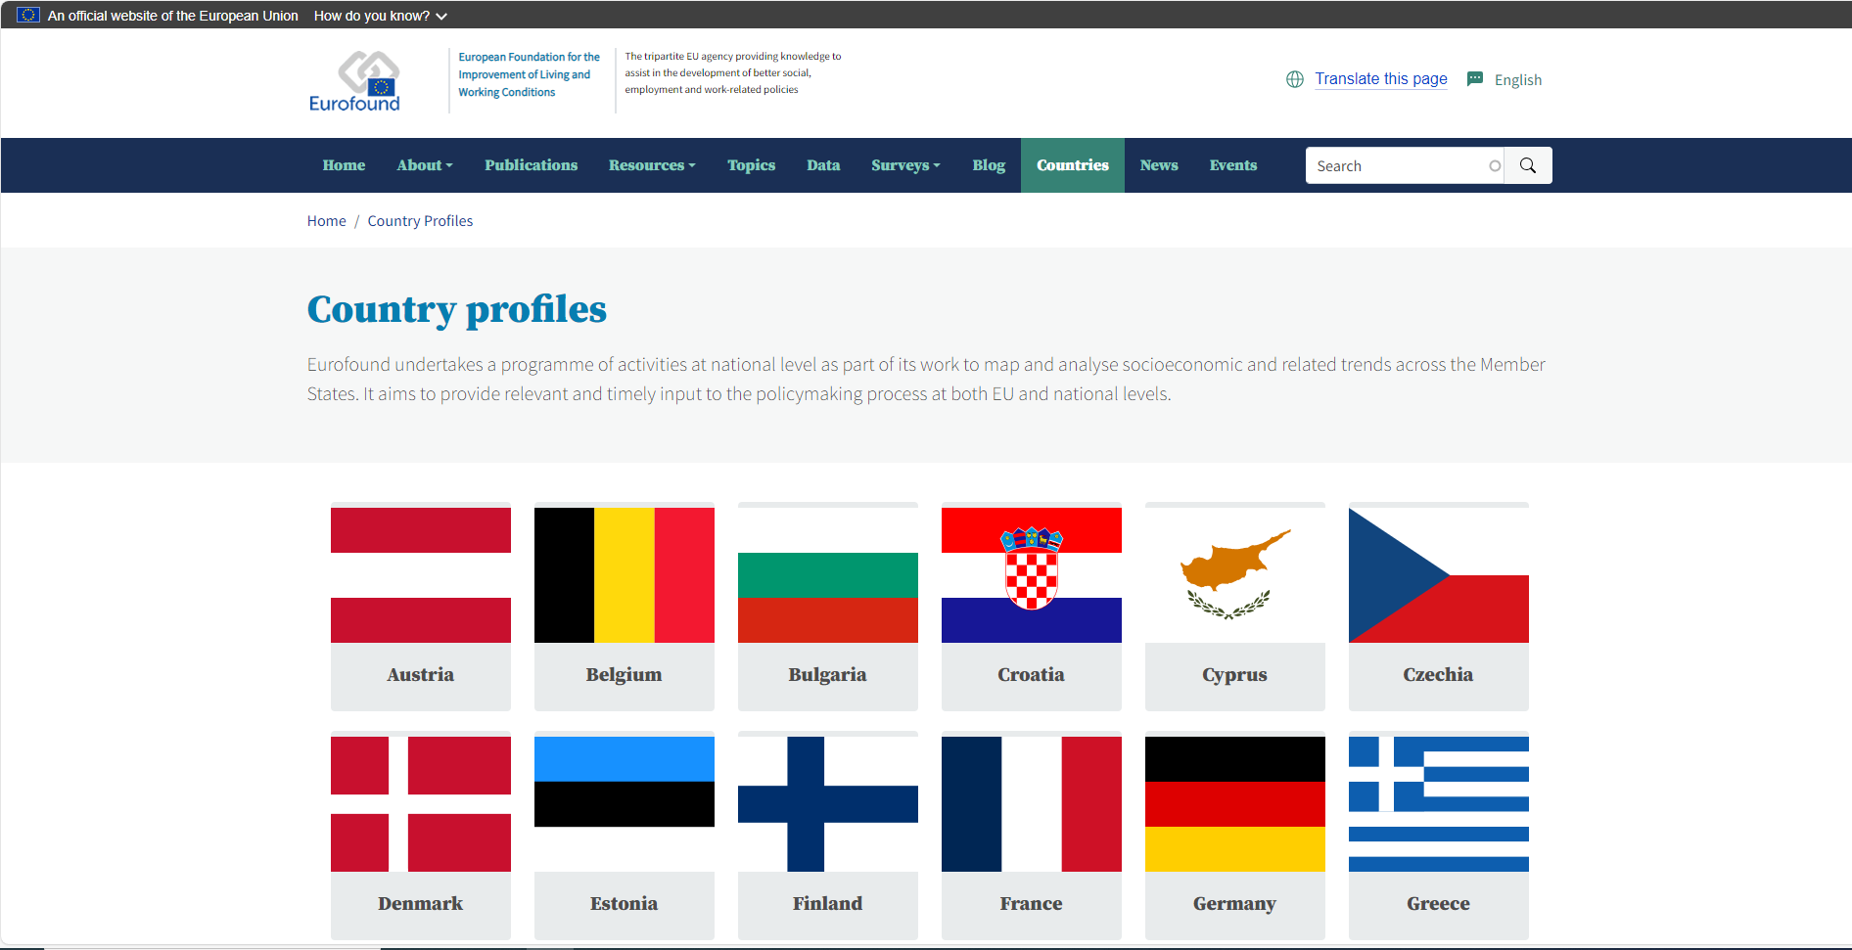
How are things organised in other countries?

Slide 10

Working life in ….Belgium
Actors and institutions
Collective bargaining
Industrial action and disputes
Pay
Working time
….
Notes:
This profile describes the key characteristics of working life in Belgium. It aims to provide the relevant background information on the structures, institutions, actors and relevant regulations regarding working life.
This includes indicators, data and regulatory systems on the following aspects: actors and institutions, collective and individual employment relations, health and well-being, pay, working time, skills and training, and equality and non-discrimination at work. The profiles are systematically updated every two years.

Slide 11
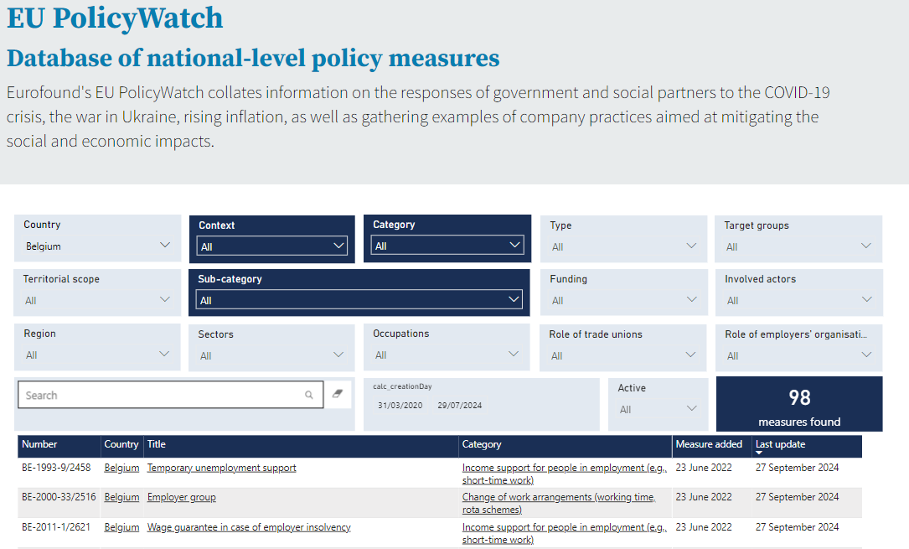

Slide 12
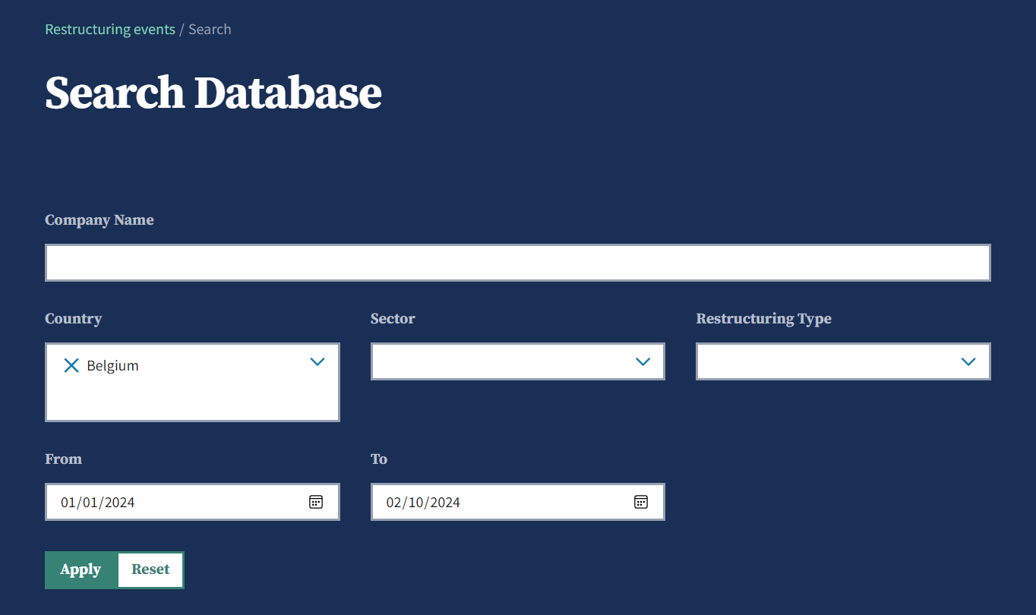
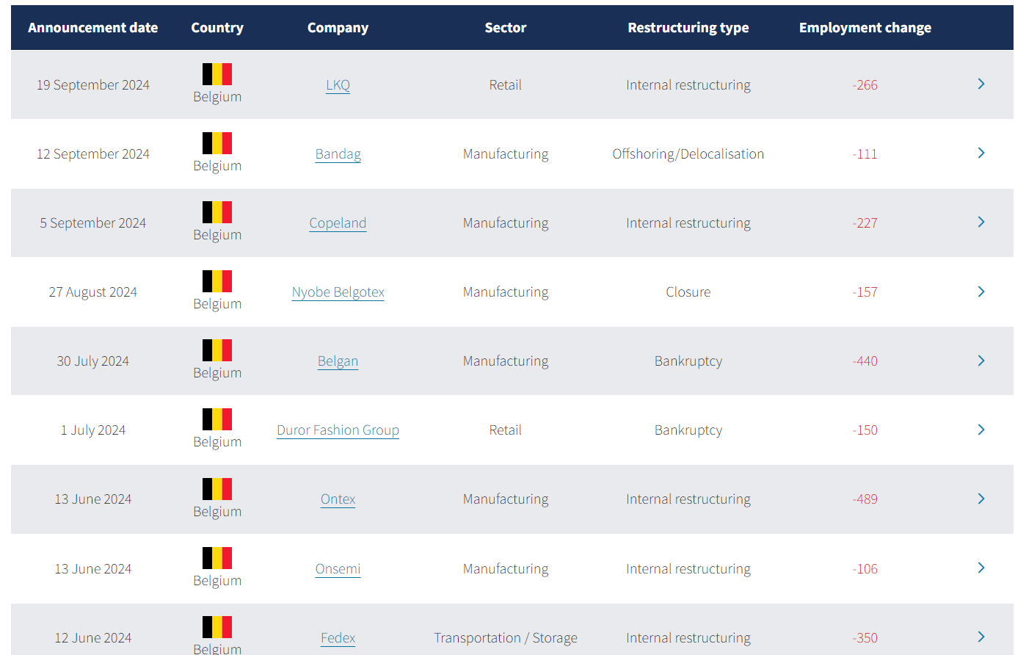
Restructuring in…Belgium

Slide 13

Exploring job quality in Europe: The European Working Conditions Survey (EWCS) ​
Notes:
Exactly a year after we started the 7th EWCS, we went into the field with a telephone survey in February 2021.

Slide 14
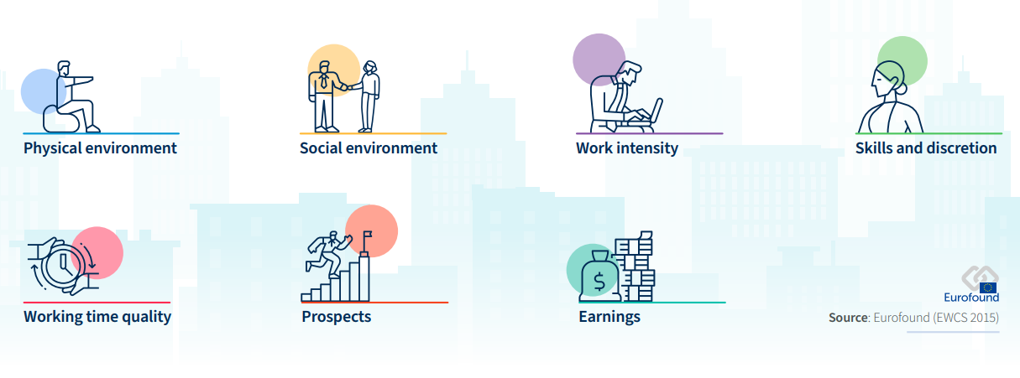
Seven dimensions of job quality

Slide 15

The European Working Conditions Telephone Survey - EWCTS
Over 70,000 interviews in 36 countries, Feb. – Nov. 2021
High quality, probability-based survey provides robust results; representative of the working population in Europe
Measures job quality and its different dimensions (OECD approach)
Snapshot of the situation in 2021
Notes:
The large sample size allows for a detailed analysis of the situation in 2021, distinguishing different groups of workers. However, a comparison with data collected in previous waves of the EWCS is not possible, because of the mode change.

Slide 16
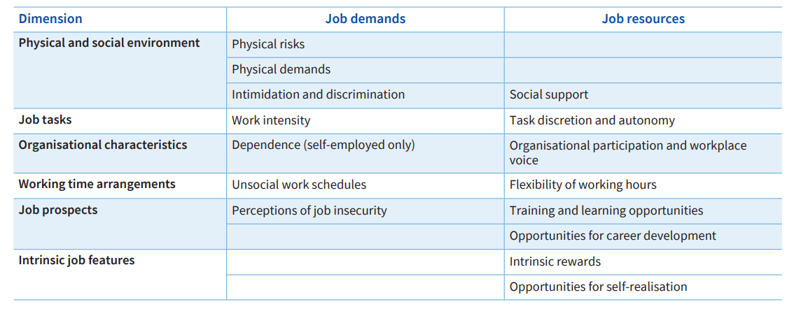
Dimensions of job quality and corresponding job demands and job resources
Notes:
As said, the redesign required a drastic shortening of the questionnaire.
The focus remained on exploring working conditions and job quality. The survey included all the questions necessary to construct the a job quality index developed by the OECD (in cooperation with Eurofound).
Instead of the seven dimensions of job quality that Eurofound’s job quality framework includes, we have six dimensions.
Each indicator has an independent influence (positive or negative) on the health and well-being of workers (epidemiological studies).
The indicators capture objective attributes of jobs – physical, psychological, social and organisational – that can be evaluated by a third party.
The indicators capture either job demands or job resources.
Job demands are job attributes that require an effort and increase a worker’s risk of poorer health and well-being.
Job resources are attributes that support workers, doing so in three ways:
by reducing job demands and their physiological and psychological costs;
by helping workers achieve their work goals;
by fostering personal growth.
Physical and social environment: Features of the physical space in which work is undertaken and the relationships between workers in the workplace. It captures three demands: exposure to physical risks, physical demands, and intimidation and discrimination. One resource is included: social support at work.
Job tasks: The conditions under which workers carry out their tasks. This dimension captures workers’ work intensity (a demand) and level of autonomy (a resource).
Organisational characteristics: The ability of workers to be part of the decision-making processes at work. One resource is examined: the practices that give employees opportunities to be involved in decision-making concerning their work. This dimension also includes one demand, relevant only to self-employed workers: dependence, as measured by a lack of freedom to make important decisions on how to run the business and recruit staff.
Working time arrangements: This dimension includes one demand, unsocial work schedules, and one resource, the working time flexibility available to workers.
Job prospects: The opportunities to advance in one’s career. One demand, job insecurity, is explored, which encompasses the risk both of losing one’s employment and of losing valued characteristics of one’s job. The dimension also includes two resources: opportunities to develop skills through training and the career prospects of the job.
Intrinsic job features: The opportunity for self-development, contributing to a goal in line with personal values. It includes two job resources: intrinsic rewards and opportunities for self-realisation.

Slide 17

Calculating job quality – examining the balance between job demands and job resources
Compare individual exposure to demands and resources
More job demands than job resources = ‘job strain’
Jobs are grouped into six levels
  Extremely strained
  Highly strained
  Moderately strained
  Poorly resourced
  Moderately resourced
  Highly resourced
Notes:
Extremely strained Cases where the gap between the proportion of job demands and the proportion of job resources is greater than 50%. This would occur, for example, when an employee was exposed to five of their possible six demands, but only two of their possible eight resources.
Highly strained Cases where the gap between the proportion of job demands and the proportion of job resources is greater than 25%, but no greater than 50%. This would occur, for example, when an employee was exposed to three of their possible six demands, but only one of their possible eight resources.
Moderately strained Cases where the proportion of job demands is greater than the proportion of job resources, but the gap between the two is no greater than 25%.
Poorly resourced Cases where the proportion of job demands is lower than or matches the proportion of job resources, and the gap between the two is less than 25%.
Moderately resourced Cases where the proportion of job demands is lower than or matches the proportion of job resources, and the gap between the two is greater than 25% but no more than 50%
Highly resourced Cases where the proportion of job demands is lower than or matches the proportion of job resources, and the gap between the two is greater than 50%

Slide 18
Distribution of job quality, EU 27 (%)
Source: EWCTS 2021

Slide 19
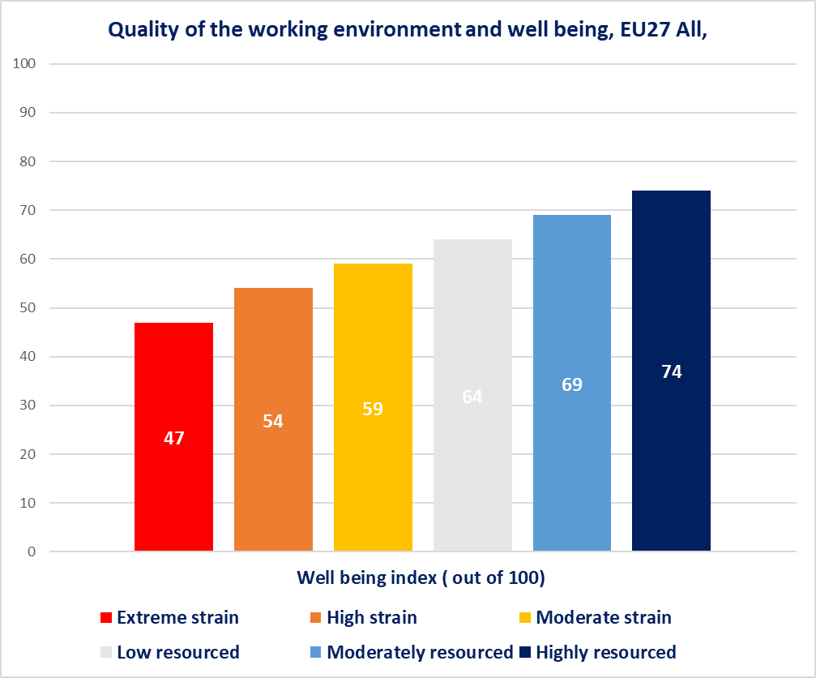
Job quality and well-being
Positive association of job quality with
Health and well-being
Engagement, trust and cooperation
Making ends meet
Work life balance

Slide 20
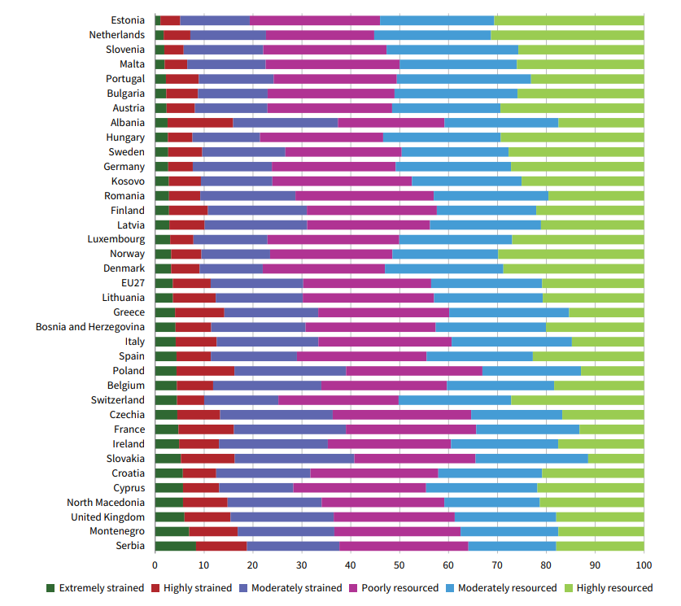
Job quality index, EU Member States and other European countries (%)

Slide 21

Keep informed
Sign up for: Eurofound’s corporate monthly newsletter
Visit our website: www.eurofound.europa.eu
Notes:
Sign up for our newsletter

Slide 22

Thank you
for your attention
bge@eurofound.europa.eu

