Slide 1

European Seminar
‘Congress Unions Working Together in Europe’
7th OCTOBER 2024

Slide 2
Syndex-who are we?
1971
Officially registered in France in 1971
1973
LIP Affair 1973 crucial turning point
1974–1982
Growth of regional offices in France 1974-1982
2000s
First developments outside France
2024
Offices in France, Spain, Belgium, Poland, Romania, UK and Ireland

Slide 3

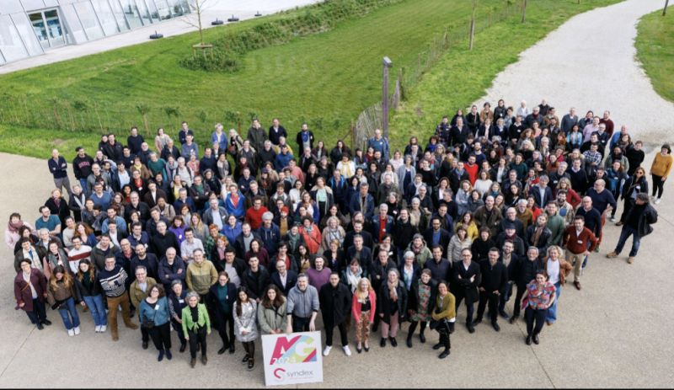
Syndex; A worker since Cooperative 2011
Syndex only works with workers and closely with trade unions
Syndex specialises in European Works Councils, working under the “Means required”
EWC Directive:"…the members of the European Works Council shall have the means required to apply the rights arising from this Directive, to represent collectively the interests of the employees.”
EWC Directive: ”The European Works Council or the select committee may be assisted by experts of its choice, in so far as this is necessary for it to carry out its tasks.”

Slide 4
Evolution of the EWC directive
1994
First EWC Directive
2009
Recast Directive
2022
Radke proposals
EWC can be “initiated” by management…or at the written request of at least 100 employees or their representatives in at least two undertakings or establishments in at least two different Member States.
Transnational issues only: Directive: For this purpose, matters which concern the entire undertaking or at least two member states are considered to be transnational…These include matters which, regardless of the number of member states involved, are of importance to the European workforce in terms of the scope of their potential effects

Slide 5
There are almost 1 200 EWCS in Europe
36% of active EWCs
There are ongoing discussions to create new EWC (such as : Just Eat Takeaway, Ryanair, WFS …)

Slide 6
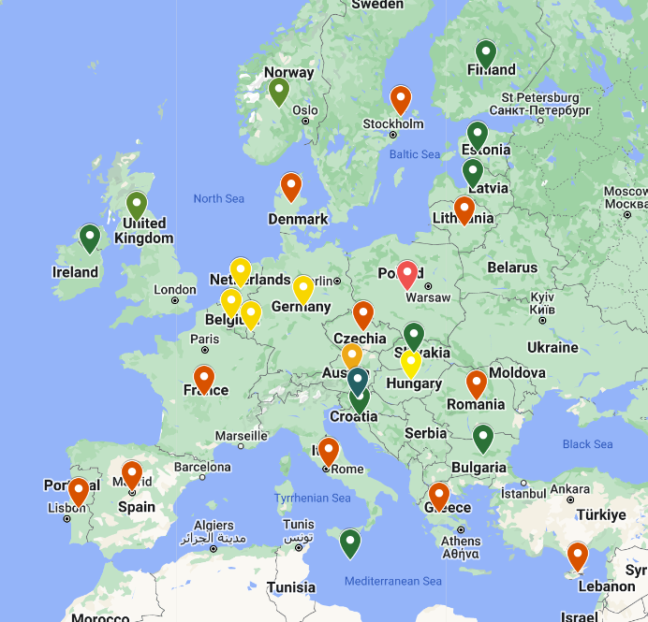
Ireland and EWCS
Transnational Information and Consultation Act 1996 transposes Directive (TICEA)
Employees in Ireland must be directly elected to EWCs. (See graph, source ETUI)
Irish legislation gives “employee representatives” the right to join Special Negotiating Bodies
TICEA: “The central management concerned shall provide…such financial and other resources as are necessary to enable them to perform their duties in an appropriate manner.”
Germany hosts nearly 25% of all European works councils, France 15% to 20%, and Ireland 12% to 15%

Slide 7
EWCs-some challenges
Confidentiality can be misused
Right to give an opinion not triggered
Resources can be a challenge
Enforcement
Agreements not being adhered to

Slide 8
YOUR CONTACTS AT SYNDEX :
Paul Dillon : p.dillon@syndex.ie

